Slide 1
Python for Security Investigations
Session One
Notes:
Hi everyone and welcome to our first class!

Slide 2
Agenda / Topics
1. Introductions
2. Syllabus
3. Create Deepnote
4. Break
5. Security Topic: Scripting Careers
6. Overflow / Q&A / Dismissal
6:30 - 7:00
7:00 - 7:30
7:30 - 8:00
8:00 - 8:15
8:15 - 8:45
8:45 - 9:00
Notes:
Today we are going to set the foundation for the semester. We will spend time up front on introductions. Then we will walk through the syllabus and highlight some ways in which this course will be different then other courses you have taken at Georgetown. After that we will introduce you to the tools we will be using to write code and interact with data; the product we will be using is called DeepNote and it is a code notebook solution. Then we will take a 15 minute break. During every class we will have a 15 minute break. When we come back from break we will introduce our first security topic which is an introduction to the cybersecurity industry with a focus on how you can leverage scripting skills in the field. Each week we will have a security topic and we have intentionally put them at the end of each session because we received feedback from the students who took this course last year that the coding skills are much more mentally taxing for many in the course and so it is helpful to have that content in the first portion of the class when everyone is most alert. Finally, for the last 15 minutes of class we will open it up for questions.

Slide 3
Reminders
Due Today
Due Next Week
Nothing! Thanks for showing up for day 0.
Practice Homework
Practice Quiz
Notes:
Thanks for signing up for the class. At the top of each class we will introduce reminders as to what is due that day and what you should be working on for the following week. This week there are no required submissions. However, for next week you’ll have your first homework assignment due. We are grading pass/fail based on submission not on the content. We just want to ensure that everyone practices getting familiar with using the DeepNote notebooks. Last semester we had quite a few instances where students incorrectly saved and submitted notebooks leading to a situation in which we received blank notebooks and the students had to rewrite and resubmit the assignment. We want to ensure that this does not occur this year and so the homework for this week will focus on just getting familiar with the interface and will give you an opportunity to practice saving and submitting your work. Similarly, know that nearly every week you will have a quiz to start the class. Next week we will have a pass/fail quiz and everyone who submits it will receive a pass. We want everyone to get familiar with the time constraints and format for the quiz. Alright, so now that those admin notes are out of the way let’s actually explain who we are!

Slide 4

Lauren Boas Hayes
She / her
Senior Advisor for Technology & Innovation
Cybersecurity & Infrastructure Security Agency (CISA)
Former roles: Threat Intelligence Analyst - Information Operations & Espionage (FB), Co-Founder (Deloitte Threat Intelligence & Analytics)
International Politics, Security Studies, Justice & Peace Studies BSFS @GU
Art, travel, sports
Notes:
My name is Lauren Boas Hayes. You are welcome to call me Lauren or Professor Boas Hayes, whichever you prefer. My career has been at the intersection of tech, security, and human rights with nearly all of my work having been in the cybersecurity field. I recently joined the Biden Administration where I serve as a Senior Advisor at CISA, the Cybersecurity & Infrastructure Security Agency. I am happy to share more with you throughout the semester about what it means to be a political appointee and what the process was like to become one. But for now I am just obligated by White House legal to state up front that all views I share in this course are my own and not an official position of the administration.
But bringing it back to the beginning of my career. I went to Georgetown! So did April actually and although we had mutual friends we didn’t meet on the Hilltop. I started my career at the State Department where I did human rights work and although it was a great experience I realized that I wanted to spend the early years of my career gaining hard skills and finding a niche in the work world which I could one day apply to work in politics and social justice work. I left State and joined Deloitte’s Cyber Risk Services division which was a phenomenal opportunity for me because they pretty much paid me to learn cybersecurity. I got to see a lot of different private sector cybersecurity teams as I hopped around from major breached company to major breached company having done work at Target, Sony, JPMC, and most of the other major breaches that happened in that timeframe. I was fortunate to be in the right place and to pitch the right people at the right time and ultimately got to cofound Deloitte Threat Intelligence and Analytics practice. I wanted to find a role that enabled me to do work that was focused on protecting people and not companies and so I joined the team at Facebook responsible for protecting users from disinformation and espionage. That is where I got to work closely with April which was an absolute highlight of my time at Facebook and I am thrilled that through teaching this course we still get to work together weekly despite me having left tech (at least for now). I really joined Facebook to focus on the 2018 midterms and 2020 elections and never planned to leave prior to the election. However, in September I got a call from President Biden’s team asking me to come run cybersecurity for the Biden-Harris Transition Team. So I took a huge gamble and left my work at Facebook to join the Transition Team which ultimately led me to join the administration. I am only in this field because a few mentors pointed me towards it and so I am really here teaching because I am excited to get to know you and to help get you into this field if it is of interest to you. Excited to talk career paths and to be a lifelong contact and to help you in any way I can. So with that I will hand it over to April to introduce herself.

Slide 5

April Eubank
Engineering Manager, Technical Research, Espionage @FB
Former roles: Security Engineer Investigator, Security Analyst (FB), Analyst (iSIGHT)
Government, Russian Language, CERES undergrad @GU
Gardening, video games, running.
Notes:
[April intro] We would love to learn a bit about you. We found last year that it was really helpful to get a sense for where each person is with their understanding of code, level of familiarity with cybersecurity, and motivations for teaching the class. We have [AMOUNT OF TIME] to get through introductions so that is about [TIME] per person. So no need to rush but please just be mindful of time so we can ensure all 14 folks get to introduce themselves.

Slide 6
Class Intros
?
Everyone Share:
Name
Preferred pronouns (if desired)
Choose Any of These Prompts:
Reason for taking the course
Experience with infosec (if any)
Experience with coding (if any)
How excited are you about this field?
Motivation for taking this class
Favorite class you’ve ever taken
Notes:
Please share your name and your preferred pronouns. From there please feel free to share answers to any of the additional prompts provided or go off script and share any relevant info you want!

Slide 7
Syllabus Walk Through
Class Format
What to Expect
Grading
Dates to Know
Notes:
We are going to take some time to walk through the syllabus so everyone knows what is ahead of us. This class involves a lot of assignments in the form of homework, quizzes, and projects. We know that many students are juggling classes, work responsibilities, family obligations, etc. so we are mindful of everyone’s outside obligations. However, we also know that there is no fast way to learn programming and the technical concepts core to work in the cybersecurity field. So all students should expect to have to do work outside of class time each week.

Slide 8
Feedback Plz!
Send Us Feedback Please!
Feedback From Last Year Operationalized
We welcome feedback throughout the semester. We will provide structured opportunities for feedback in the form of surveys and you are also welcome to send us an email or share your feedback in office hours at any point throughout the semester!
Slower pace to teaching code
Front load code content in class
Better integrate cybersecurity content and code content
Virtual works
Office hours should be held a couple of days after class
Notes:
We try to be maximally open to feedback throughout the course so we will provide structured opportunities for feedback in the form of surveys and we also welcome emails at any point as well as conversations during office hours.
This is our second year teaching this course and we have made a lot of changes to the course structure based on feedback from the previous cohort. We have two goals with the course rewrite we have undertaken: First, we slowed down the python content a lot. Our goal here is to make sure that you have enough time to really master the fundamentals. And we are teaching the coding concepts first in class so as to teach the most mentally taxing work when everyone is most alert.
It is important that we share some context here on how we are pacing the class. The content we are teaching over the first 6 weeks of class is typically taught in the first 2 weeks of an introduction to computer science class. We share this to give you confidence that you will have the requisite time to master this content. Since this course assumes students have no prior coding experience we want to make sure that everyone has the opportunity to master the fundamentals. However, if you are a student with preexisting coding experience and you find as we go along that you would like more challenging content please do not hesitate to reach out to us and we can point you towards some more advanced content to ensure you are also getting as much out of the class as you want. Second, we tried to better integrate the cybersecurity content with the python. What this means in practice is that we will be using a data source (VirusTotal) which is a set of cybersecurity data. Last year we instead used Twitter and we found that students tended to orient projects towards non-security projects because they were more familiar with other topics. While this led to some fun projects it didn’t appropriately tie together the two core aspects of class.

Slide 9

Lesson Learned: Virtual Class + Optional social meetups
All classes and office hours will be held virtually. We will use the same Zoom link for class and office hours.
We will also organize some optional social meetups to get to know each other.
Notes:
One of our lessons learned from last year was that the virtual format really worked for this class because all of the materials and skills are digital.
Please note that we will use the same Zoom link for class and office hours.
We would still love to meet you in-person so we will organize some optional social meetups throughout the semester.

Slide 10
Lesson Learned: Office Hours
All classes and office hours will be held virtually. We will use the same Zoom link for class and office hours.
We will also organize some optional social meetups to get to know each other.
Notes:
A note on office hours. Office hours will be held on Thursday night and you can drop in at any time; you do not need to sign-up for a particular time slot. Office hours are optional. However, we strongly strongly encourage everyone to attend. As the semester moves along and you start to be responsible for independent code you will want to come to office hours because this is your opportunity to have us help you work through bugs in your code. It is really really hard for us to give you feedback on code in email. This is because often there isn’t just one specific issue with a notebook, often there is a cascading series of issues which really require discussion and hands on trial and error problem solving to figure out the issue. This is a critical skill to learn to become proficient in coding and is one best taught with work you care about (such as projects). For this reason we want to make it very clear that we will answer 100% of questions we receive during office hours. However, we cannot commit to answering all answers received via email. Often those will take 4x as long to answer and be less effectively answered.
We found last year that the difference between students who struggled in the course but succeeded and ended up loving the material and those who just struggled was whether or not they committed to office hours.
If you cannot make office hours due to recurring obligations please let us know early so we can work with you to ensure you have support from us.

Slide 11
Our Observations and how we are modifying approach accordingly
Syllabus updates to focus on strengthening non-coding skills
Focus on teaching students to structure analytic questions such that it is possible to answer the questions through data analysis
Teach intelligence writing basics
Expect more depth from students on cybersecurity topic content
Notes:
Last year we made some assumptions which we realized were inaccurate and so we are trying to intentionally address those through syllabus changes:
Students do not have a lot of experience with data-informed analytical writing
Students do not have a lot of experience with crafting analytical questions for investigative projects
Students do not have a hands on understanding of cybersecurity topics

Slide 12
Syllabus: Use of Others’ Work
A lot of a programmer’s work is Googling to figure out how code works, therefore, we allow and expect you to use publicly available resources to answer questions as you work through the course
It is absolutely acceptable to submit someone else's solution that has been found online for a non-exam coding problem; it is not acceptable to submit a solution without an explanation written in the student's own words explaining in detail how the solution works and where the solution came from.
Notes:
A lot of a programmer’s work is Googling to figure out how code works, therefore, we allow and expect you to use publicly available resources to answer questions as you work through the course.
It is absolutely acceptable to submit someone else's solution that has been found online for a non-exam coding problem; it is not acceptable to submit a solution without an explanation written in the student's own words explaining in detail how the solution works and where the solution came from.
We will make it extremely clear when you can and cannot use outside resources. Or, when you can and cannot use your DeepNote notebooks as part of an exercise. Please know up front that there are times when it would be reasonable for a human to produce a different answer than a notebook would. This means that we will often be able to tell if you are not following the guidance for a given project. We share this not to scare you but just to be honest about the fact that it is not that hard for us to identify when students are skirting the requirements. Do not put us in a position of having to penalize you. We are making the course maximally open so please stay within the guidance we provide.

Slide 13
Contact Us Proactively to discuss any challenges you may be having
A lot of a programmer’s work is Googling to figure out how code works, therefore, we allow and expect you to use publicly available resources to answer questions as you work through the course
It is absolutely acceptable to submit someone else's solution that has been found online for a non-exam coding problem; it is not acceptable to submit a solution without an explanation written in the student's own words explaining in detail how the solution works and where the solution came from.
Notes:
Our goal is for every single person to thrive in this class and to do work that is interesting to you and which expands your skills. This class will also hopefully be challenging to everyone. If you are experiencing any sort of challenge and need to work with us through something please contact us as early as possible. For example, we appreciate the two people who contacted us to let us know they would miss a class and to ask if that is manageable. Similarly if you anticipate needing an extension on an assignment please reach out and do not just not submit the assignment and hope for the best.

Slide 14
Sidebar: Difficulty & Revision Strategies
What to expect from a “beginner-friendly” coding class in a non-CS degree program.
Notes:
For most of you this is likely your first exposure to coding and you probably have a lot of questions around what to expect in terms of difficult from a coding-oriented course in a non-CS program like SSP. I’m going to briefly break down our philosophy on the class and what you should expect to see.
We want this course to be accessible for complete beginners and, to do that, we are starting with the precept that you have no prior experience with code at all. We are breaking down traditional CS concepts into very small chunks and using the mosts accessible programming language from the industry that we can to try to make this approachable. And we will be available during office hours every week to answer questions, find additional resources, etc.
With that said, learning to code is very much like learning a foreign language, and it is going to require practice and study outside of the classroom and outside of the assigned homework for you to be successful. So, what does that mean for the course?
We have designed homework and quizzes that are relatively lightweight in terms of the amount of content that we will ask you to complete. Problems are selected to demonstrate various edge cases and challenge your understanding of the subject matter. The goal is to help you identify blind spots in your understanding before you get to an exam or real-life situation and don’t have the right skills to solve the problem presented.
We are leaving them lightweight enough that you can choose where you need to focus and study to fill in gaps and with the expectation that you’ll do so.
For most coders, the amount of work we are assigning is insufficient to build “muscle memory” around how to problem solve in code. The best analogy I can give is from foreign language classes - us giving you a worksheet to define vocabulary wont guarantee you have it memorized just by filling out the sheet. Throughout the semester, you will need to engage in independent study or the exams will be very difficult.
Many resources exist for finding coding challenge problems online. You can find several in the syllabus.

Slide 15
REvision Strategies
Language Constructs: Recognizing what different components of the language are and how they work.
Algorithmic Thinking: Understanding which constructs will help you solve a problem and how to use them in context.
Scripting
Building self-quiz materials based on key terms, materials, and syntax for common constructs.
Practicing challenges that involve reading code, writing code, and debugging. Puzzles where you need to determine which constructs/concepts to apply.
Notes:
My personal recommendation is that, for the scripting itself, you focus on two different types of study. First, focus on the content itself. Definitions, syntax, and other foundational constructs are often best studied through the creation of self-quiz materials (think physical or virtual flashcards, quizzes to return to later, challenge problems you’ve written yourself). I recommend creating study materials after each class and using them to review in an ongoing way up to the midterm.
The second area is to focus on ‘algorithmic thinking’ or problem solving in code. For this, I recommend doing a ton of coding challenges. My base recommendation is ten minutes minimum per day of challenge problems outside of the homework assignments. By repeatedly solving problems you will start to recognize certain common refrains or structures in problems and start to be able to immediately tell which constructs that we’ve covered will help you solve problems that look similar to others you’ve seen. This kind of intuitive recognition is hard to build except through repeated exposure.

Slide 16
Questions on the Syllabus?

Slide 17


Using Deepnote to start coding in python

Slide 18
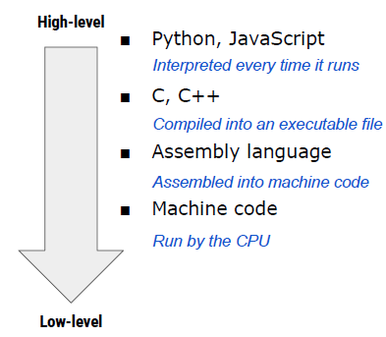
Why Python?
Notes:
Programming is giving a set of instructions to a computer to execute. And programming languages are the tools we use to write instructions for computers to follow. Programming languages each have their own vocabulary and set of grammatical rules for instructing a computer or computing to perform specific tasks.Computers “think” in binary — strings of 1s and 0s. Programming languages allow us to translate the 1s and 0s into something that humans can understand and write. A programming language is made up of a series of symbols that serves as a bridge that allow humans to translate our thoughts into instructions computers can understand.
Programming languages exist on an abstract spectrum that runs from high-level (human interpretable) to low level (machine interpretable). Languages that need to be either interpreted or compiled into machine readable instructions are considered to be “high level”. Languages that are particularly high level - like Python or JavaScript - are going to be relatively more readable to a lay person with no knowledge of programming than lower level languages because they will use words (like object, order, run, class, request, etc.) that are closer to the words we use in our everyday lives.
“Low-level” programming languages are closer to machine code, or binary. Therefore, they’re more difficult for humans to read (although they’re still easier to understand than 1s and 0s). The benefit of low-level languages is that they’re fast and offer precise control over how the computer will function.
In our course, we do not need the level of control offered by low-level languages. Python will let us get working quickly and do some of the very complex analysis that we need to do right out of the box.
But still, why Python vs another “high-level” language?

Slide 19
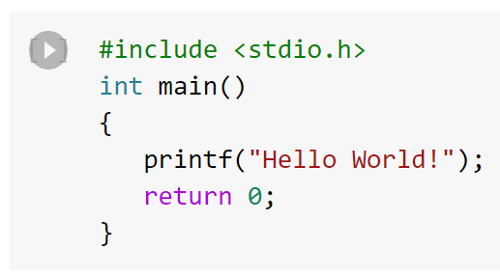
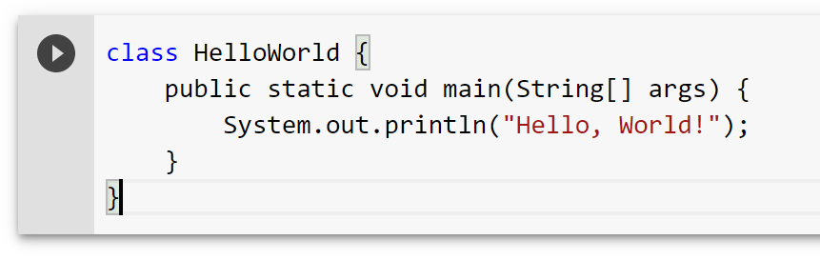
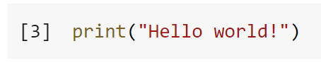
Why Python?
The code on this slide is the string “Hello World!” in multiple languages:
Binary
01001000 01100101 01101100 01101100 01101111 00100000 01110111 01101111 01110010 01101100 01100100 00100001
C
Java
Python
Low Level
High Level
Notes:
“Low-level” programming languages are closer to machine code, or binary. Therefore, they’re more difficult for humans to read (although they’re still easier to understand than 1s and 0s). The benefit of low-level languages is that they’re fast and offer precise control over how the computer will function.
In our course, we do not need the level of control offered by low-level languages. Python will let us get working quickly and do some of the very complex analysis that we need to do right out of the box.
But still, why Python vs another “high-level” language?

Slide 20
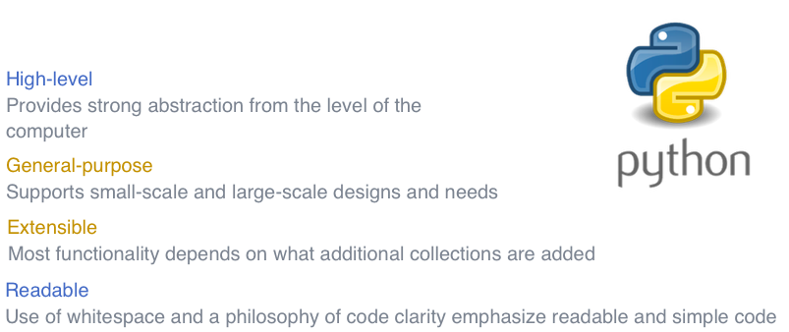
Why Python?

Slide 21
Where to code
Benefits of Using Deepnote
Deepnote will feel a lot like Google Docs to you. For example, as you write code it automatically saves.
You can share your notebook with an individual or with our class’ team.
People can leave comments and respond to comments on notebooks.
Notes:
Let’s say you type 1+1 and hit enter in Microsoft Word. We do not expect it to tell us 2. We just expect to see 1+1 on the page. Whereas, if we type 1+1 into a calculator app we expect that we will get 2 as the result when we click enter. We subconsciously have lots of learned expectations around how various interfaces will interpret our input.
To use code we will need an interface which when we give it python it will interpret that input as python and output the appropriate response. There are many different ways to interface with code but for this class we will be using a cloud-based interactive program called DeepNote. DeepNote is built around another product which is very common in data science work called Jupytyr notebooks. Last year for class we used Google’s notebook product called Collab but we felt it lacked some collaboration features which will make it easier for us to provide feedback on assignments and to help you debug. So we are trying DeepNote this year. I share this not to overwhelm you with product names but to ensure you know that this is only one way to interact with code and if you work somewhere that leverages code or read a python book you may come across other products.

Slide 22
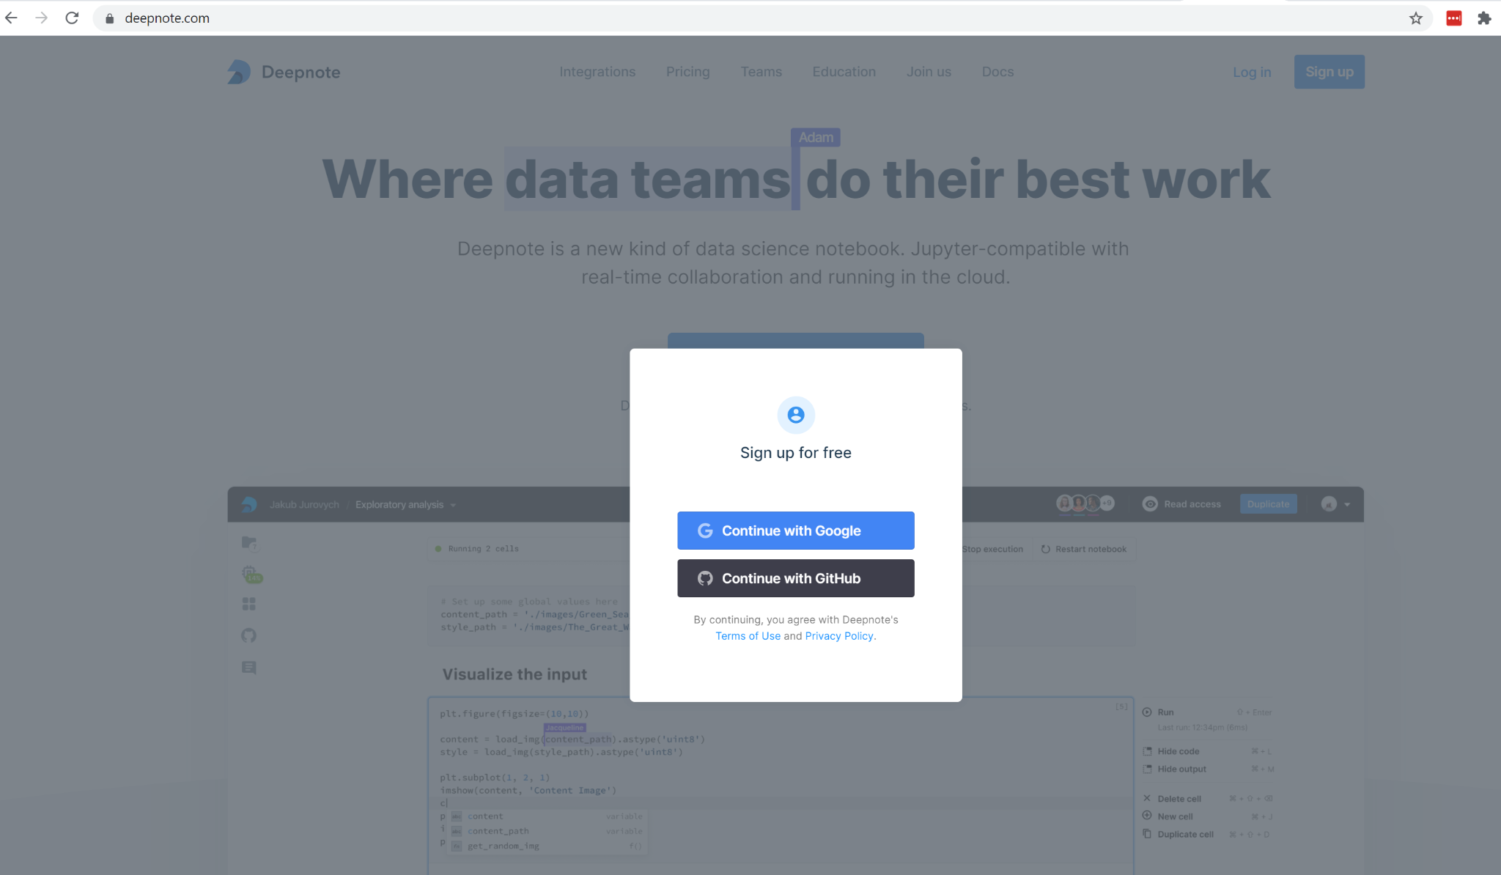
Getting Started on Deepnote
Head to deepnote.com
Click Sign up
Continue with Google
Login using your netid
Notes:
[April]

Slide 23
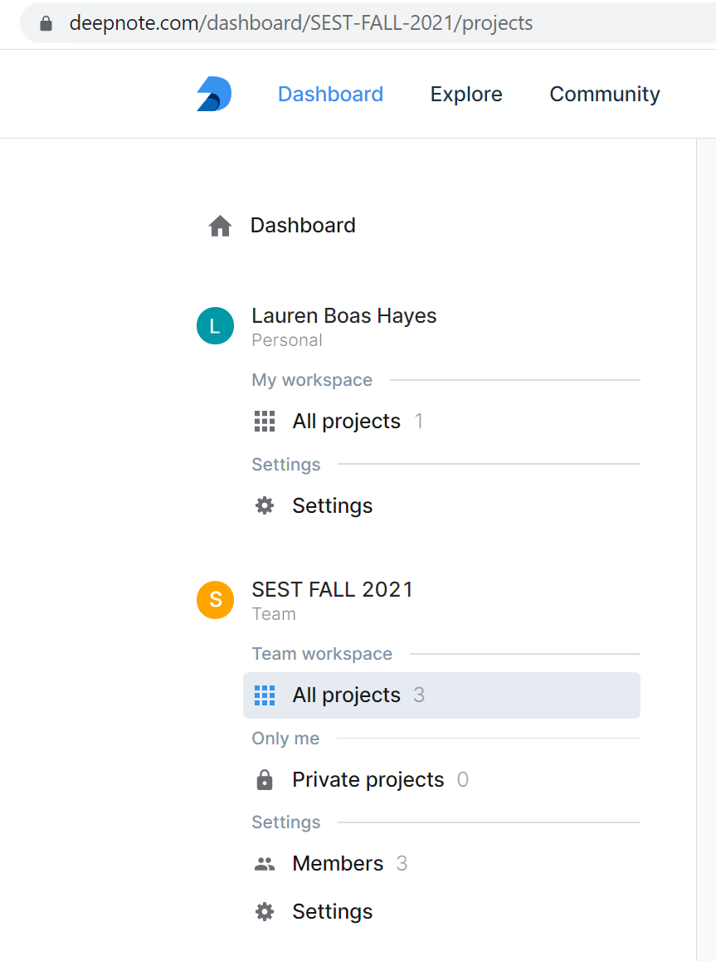
DeepNote Class Space
Please keep all of your shareable class work in the class’ Team workspace.
We will share notebooks with everyone on the team.
You will want to keep your notebooks in your private projects space. Then when you want to submit them to us you can add April and I onto the notebook.
Notes:
Please keep all of your shareable class work in the class’ Team workspace.
We will share notebooks with everyone on the team.
You will want to keep your notebooks in your private projects space. Then when you want to submit them to us you can add April and I onto the notebook.

Slide 24
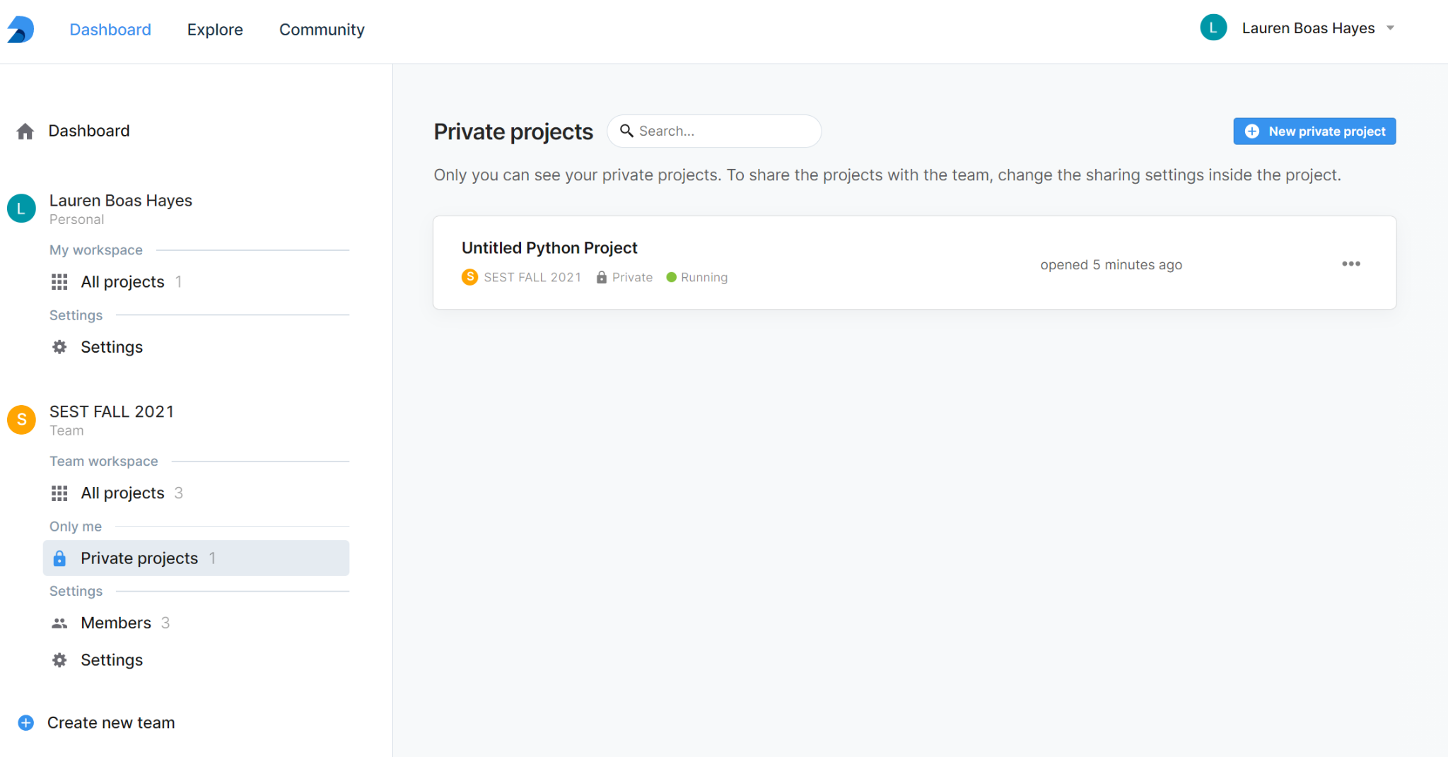
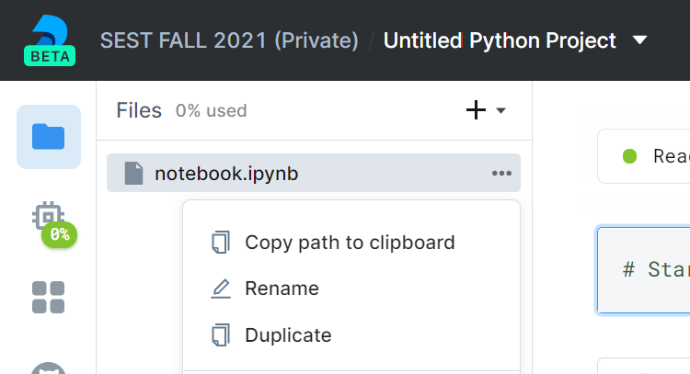
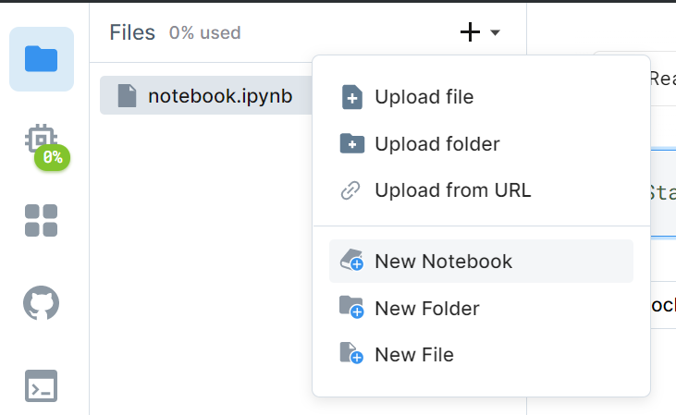
Name your notebooks!
Open a notebook in your private projects by:
Clicking “Private projects”
Clicking “New private project”
Next ensure you name your notebook by:
Clicking on the folder icon
Clickon the three dots
Selecting rename
Giving the notebook a name
Once you are in your Private projects you can create new files by clicking on the + sign and then selecting “New Notebook”
Notes:
Pro tip - name ALLL of your notebooks. When you are starting out this will feel like a no brainer but you will find that once you get into more ambitious coding projects you will probably end up with 10s of notebooks per project. It goes a long way to even just give them simple names.

Slide 25
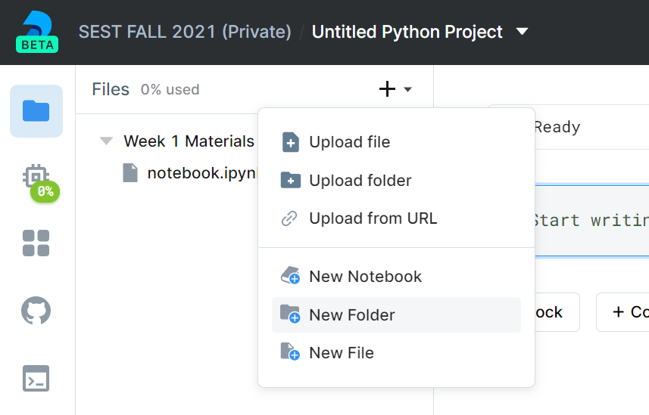
Keep your notebooks organized
You can keep materials organized by creating folders and nesting your notebooks within the folders.
Notes:
You can organize notebooks within folders.

Slide 26
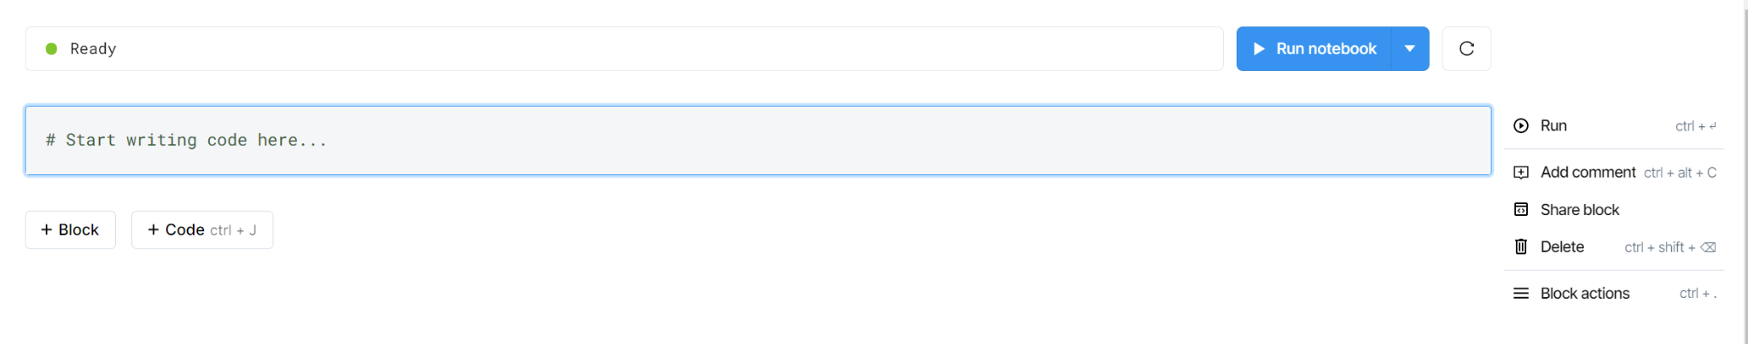
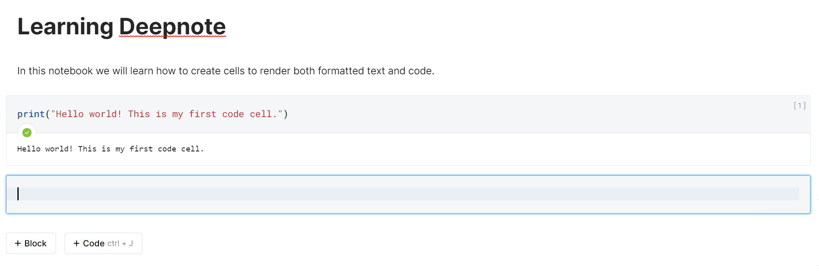
Using Deepnote to write markdown and python
Notice that code cells are gray whereas the text cells are white.
Also notice that the code has fun colors happening by default.
Notes:
Each of these gray rows is called a cell. In each cell you can choose to write with human readable words or with code. You will select either “Block” or “Code” depending on which you are trying to use.
To start with let’s give our notebook an introductory cell using human readable content. I selected “Block” and then “Heading 1” and typed “Learning Deepnote”. Then I created a new cell and selected “Paragraph” and wrote “In this notebook we wil learn how to…”
Next I clicked “Code” to create a code cell and typed in our first string of Python! print(“Hello world! This is my first code cell.”)
Notice that when I start using a code cell text will appear in a variety of colors. This helps us to know that we are using proper syntax and that our code is ready to run.

Slide 27
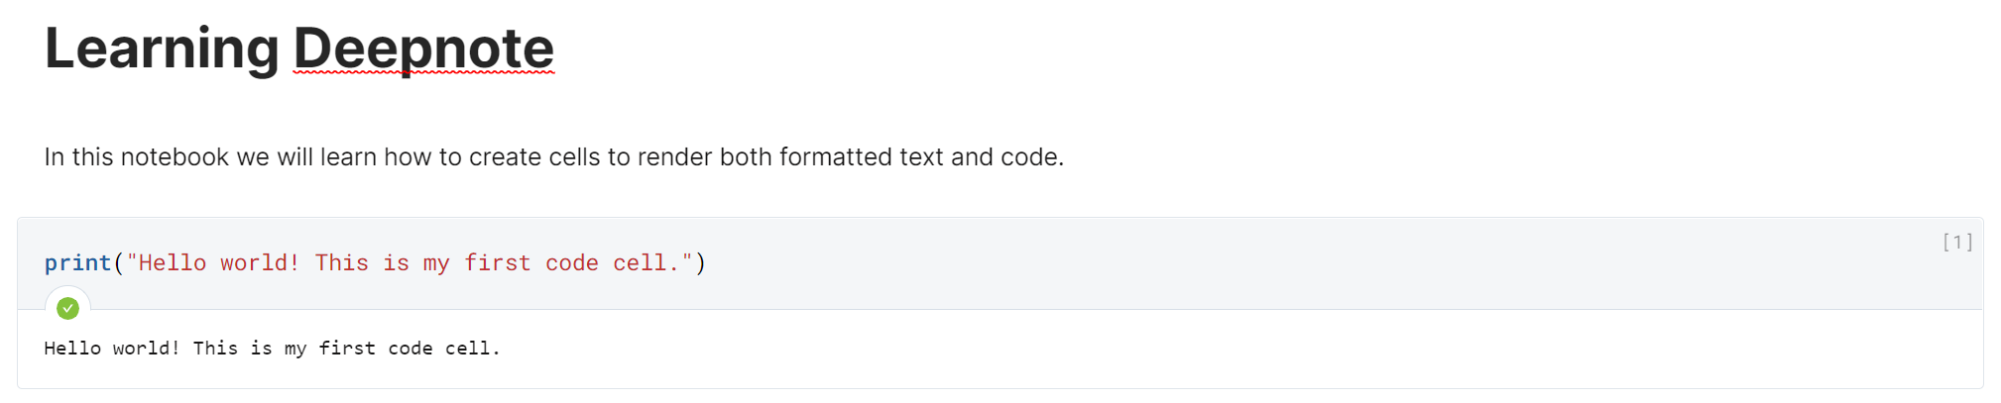
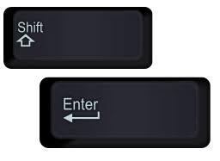
Repeat After me “to run code hit Shift enter”
Notes:
To run a code cell you hit shift and enter. You can alternately click “run” however this is slower and a total noob move because no one who is writing hundreds let alone thousands of lines of code has time to be clicking run with their mouse.
When the cell completes running you will a small number on the leftmost part of the cell. This shows you that this cell has completed its run.
In Deepnote they also give you this green checkmark to show you that your code executed successfully.
We will learn more about the print() function (and what a function is) later in class. But for now just know that as you can see here it prints out whatever you instructed it to print. In this case we instructed it to print the words (in python called a string) “Hellow world! This is my first code cell.”

Slide 28
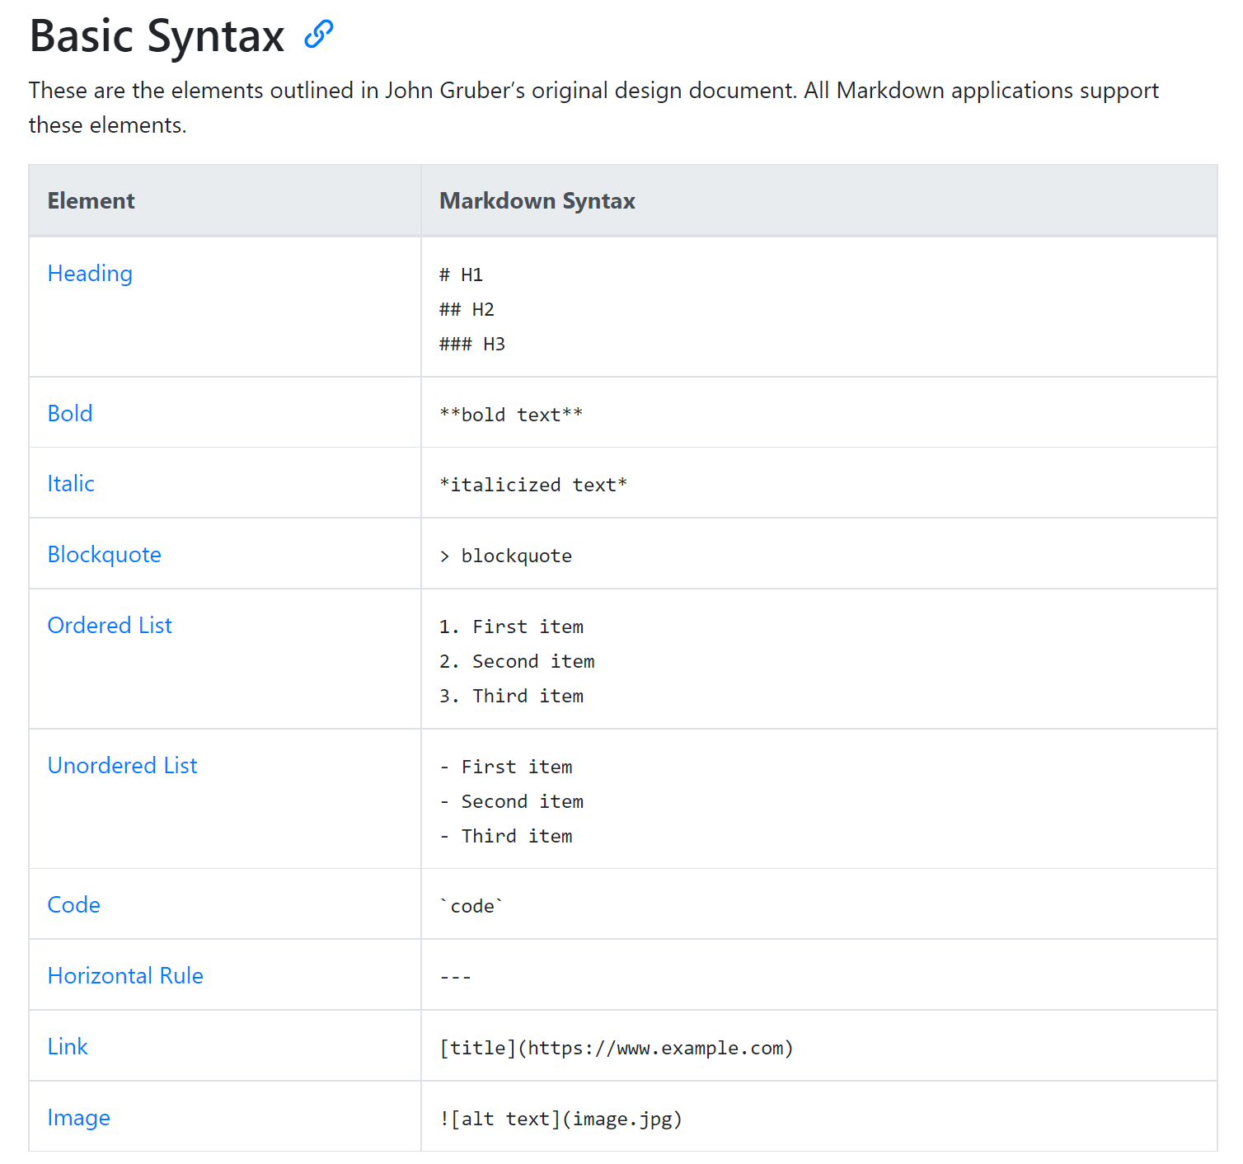
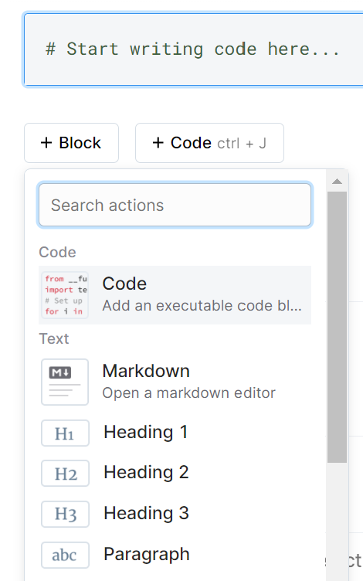
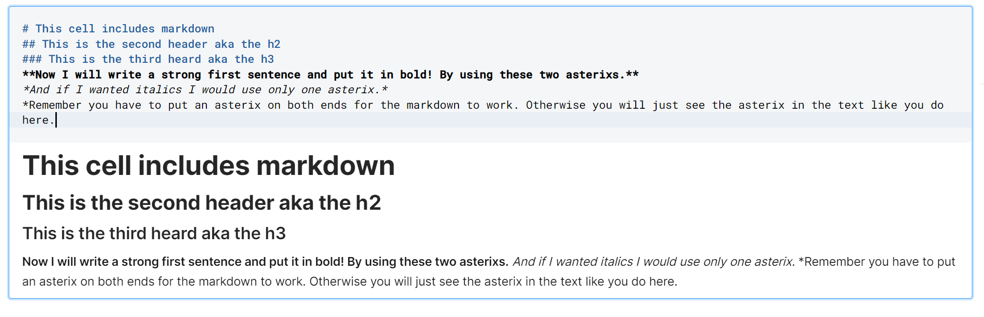
Introducing Markdown
Notes:
Surprise! When you start learning to code you will quickly realize that there are actually a ton of programming languages and you are going to learn more than one because there are lots of languages which are really helpful for specific purposes. For example, when you want to write human readable language with some very basic formatting there is a language called Markdown. With markdown you can use some basic syntax to make your font appear as a header, to make text bold, etc.
You can find more info about markdown and a cheatsheet of basic markdown syntax here:
https://www.markdownguide.org/getting-started/

Slide 29
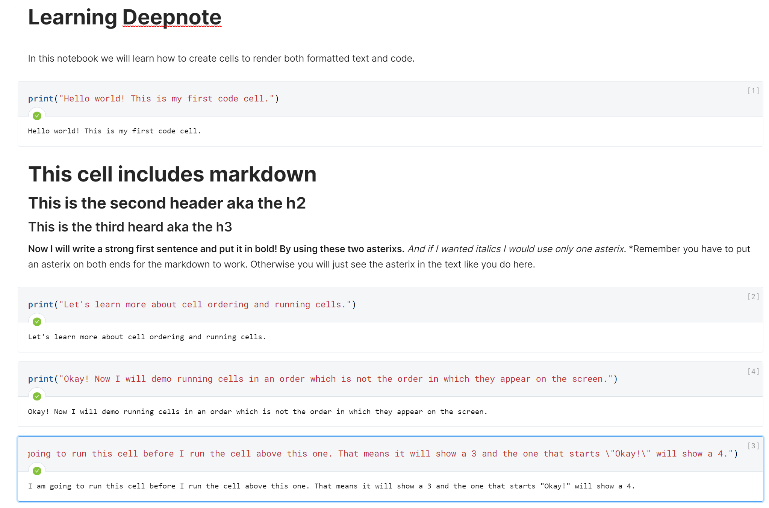
Ordering of cells vs order in which you run cells
It does not matter what order code is written in, the order in which you run the cells matters
Notes:
This is a really important concept to understand. It does not matter what order you write code in because it is when you run the code which is important. For example I can write top to bottom in a notebook. But if I choose to run the cells from the bottom to the top the notebook will show that the bottom most cell ran first (and will show a 1 in the right side of that cell). In the example on the slide I ran the top cell first, then the cell below that second, then I ran the cell on the bottom third, and the cell above that one fourth. You can run any cell in a notebook whenever you want independent of where it is on the screen. This is important to know when you have code which builds on itself. If you have to run a particular piece of code for the second piece of code to work you will want to remember to run the cells in that order even if they dont appear in that order on your notebook.

Slide 30
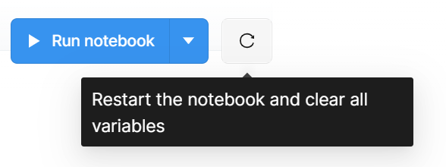
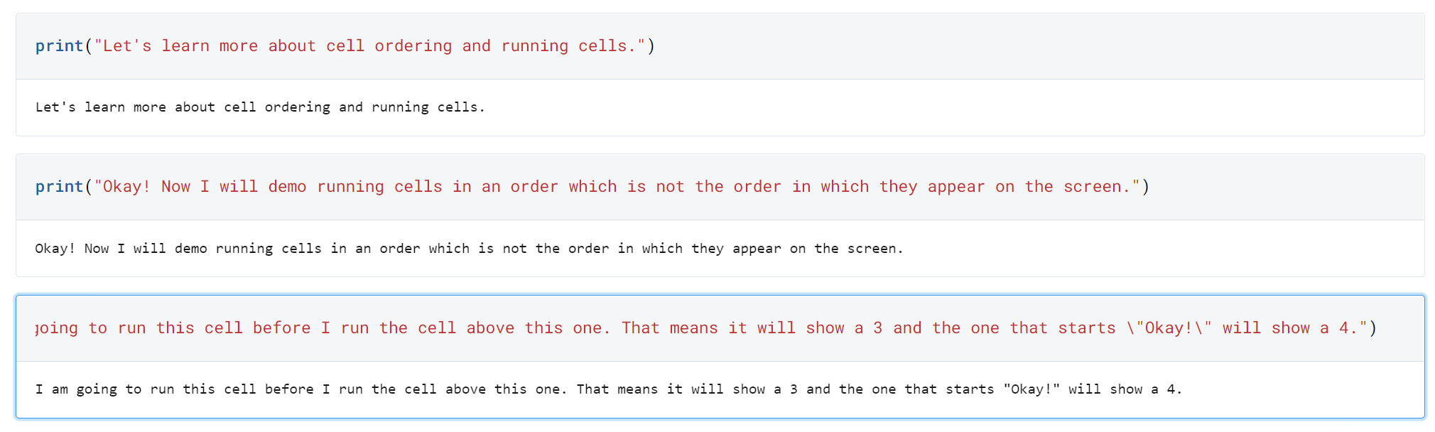
Clearing Data from Your Notebook
Since the order in which you run cells matters sometimes you will want to clear your saved data.
Notice there are no numbers.
Notes:
When you clear your data you will retain the code you have written in the notebook but you will see that all of the little numbers which indicate when the cell was run will go away and you will be returned to a blank slate to run the cells in whichever order you would like to proceed.
You can clear your notebook by clicking on the little swirling arrow to the right of the “Run notebook” button.

Slide 31
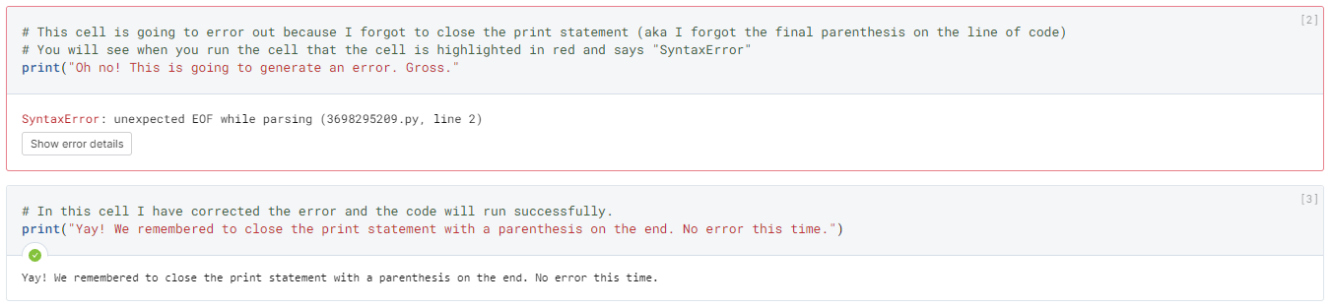
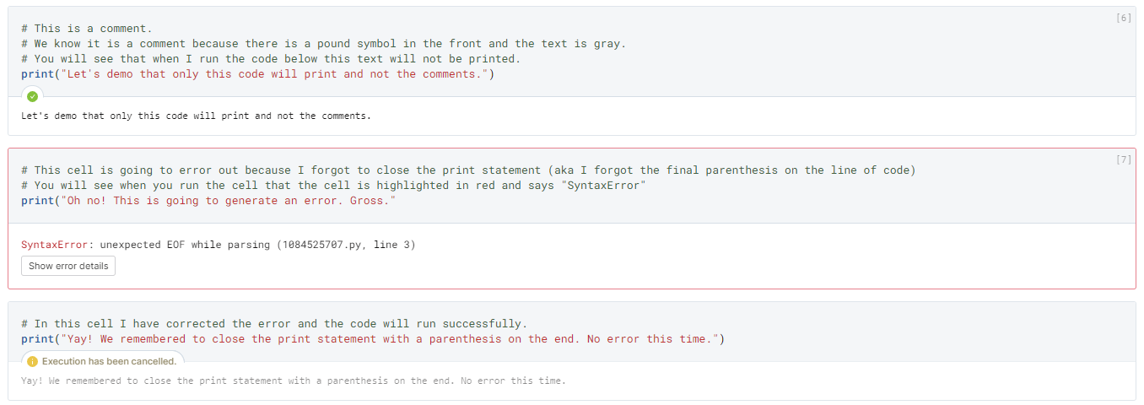
Errors
If you write your code incorrectly and try to run the cell you will get an error. The cell will be highlighted in red and you will see an error code such as “SyntaxError”
If you choose “Run notebook” and then have an error the notebook cannot proceed with running the cells which come after the error
Notes:
If you write your code incorrectly and try to run the cell you will get an error. The cell will be highlighted in red and you will see an error code such as “SyntaxError”. Learning to fix your code is an important skill called debugging. We are going to cover debugging in greater depth later in the class once we know how to use more python. However, for now, as you familiarize yourself with Deepnote it is important to know that if you try to run a whole notebook, by clicking “Run notebook” the blue button at the top, the notebook will execute from top to bottom until it hits an error. Then it will stop and be unable to run any of the following cells.

Slide 32
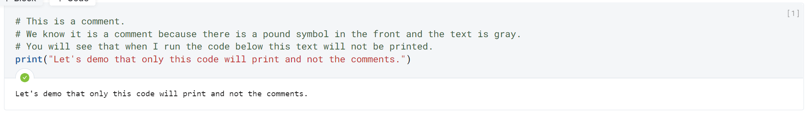
Commenting Your code
Annotating (aka Commenting) your code is good practice. It helps you know what you did and helps others follow along
Comments are text which is ignored by the interpreter.
This means that you can put human readable text in a code cell alongside code.
# Is used to start a single-line comment
You can comment in bulk by highlighting code and hitting command + ?
Notes:
Something to practice early on is commenting your code. This just means adding human readable explanations for your code. You can write a single-line comment by placing a pound # (hashtag) at the beginning of the line. The interpreter (Deepnote) will just ignore that and know it is not code. You can see in the example on the slide that we have 3 lines of comments and then a print statement. When we run the cell the only content which prints is the info in the print statement not the three preceding lines of comments.
We are going to stress comments now but really encourage you not to forge this moving forward. Please comment to explain your thought process. If we are grading something and we see a comment which explain what you were trying to do and then code that totally doesn’t achieve that goal we may still be able to award you points because we knew you understood the approach and just couldn’t execute in code. This is a far better position to be in then just giving us incomprehensible code and leaving us no option but to guess as to what your intent was. It is also a great teaching mechanism because it may help us understand where your understanding is flawed.

Slide 33
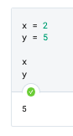
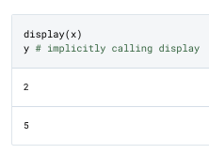
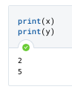
Print & Display
Deepnote assumes you want to call display on the last item in a cell if you do not take an action on it.
It will not display an item if you do take an action on it unless you explicitly call display.
You can display multiple items.
You can also use print to view multiple items in one display window.
Viewing objects in your code editor.

Slide 34
Resources for SElf help
Python documentation: The Python docs will explain and show examples of how different pieces of code work if you search within it.
help(x): in your interpreter (in our case, deepnote), you can wrap the help() function around anything you’d like to understand. It will try to return the relevant docstring - a short piece of documentation that accompanies each piece of code.
??: A notebook-specific “magic” command that will show the source code for a function or other component. Call it with the syntax <function>?? (e.g. print??).
Before you jump right to googling, asking a friend or trying to email - try these.

Slide 35
Testing Deepnote
Let’s load up and test out deepnote.
For our first exercise, we’re just going to make an account, open the UI, and open a shared notebook.
We’ll all have access to it and you can try testing out features or cloning it on your own.
We will add some pseudocode to the notebook with comments.
Psuedocode

Slide 36
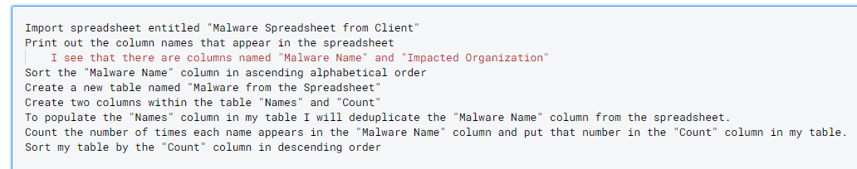
Pseudocode
Writing pseudocode can help you think through what you need to code and can help you find gaps in your planned program. Pseudocode follows the flow of code while using human-readable non-code words:
Notes:
There are many ways to break coding challenges down into more manageable problems. One tool that can be helpful throughout your career and especially as you are beginning is to write out what you want to accomplish in pseudocode. Pseudocode just means a structured plaintext outline of how you will structure your program. When you write pseudocode your goal should be to try to write something out with a logical flow but without being worried about needing to use appropriate code syntax.
For example, if right now, in minute 10 of this intro to python course I asked you to write a program for me in Python which would find the most common malware sample in a spreadsheet full of malware samples I anticipate I would get a lot of blank stares. However, if you were to start attempting this in pseudocode you could just write out an approach:
First, I am going to have to access the spreadsheet in Deepnote somehow.
Then, I am going to have to figure out how the malware data appears in the spreadsheet. Let’s say I find there is a column of data entitled “Malware Name”
Now I need to organize those names. Maybe I want to sort it so that the names are in ascending alphabetical order.
Now I will create a new table with two columns “Malware name” and “Count”
I will return to the original spreadsheet and I will deduplicate the “Malware Name” column. That data will now go into my new table under the “Malware Name” column.
Then in my original table I will count up how many times each malware name appears and I will record that number in the appropriate row in my table.
Finally, I want to figure out which one was the most common so I sort the table by the “Count” column in descending order.
Wohoo! The row at the top of my table is the most common malware from the spreadsheet!
This is pseudocode. As we get more familiar with coding you will come to realize that it will save you a lot of time with your projects if you outline your approach using pseudocode first. Then you literally just go line by line through your pseudocode converting each line of the pseudocode into real code. If you realize you made a logical error in how you structured your pseudocode then before you start trying to write the real code go back and update your pseudocode so you know where you will need to modify the real code.

Slide 37
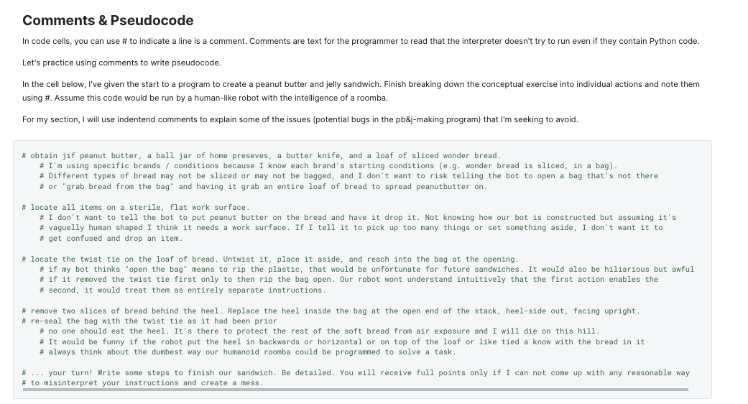
Pseudocode Exercise

Slide 38
Code REview From This Session
New Data Types Fundamental Python constructs that define how data is stored and what can be done with it. | None
New Concepts Ideas, concepts, or other abstract processes for working with code. | High & Low Level Programming Languages Python Notebooks & Deepnote How to use Deepnote Looking for code online, docs, tab completion, help Pseudocode
New Operators Python foundational operators that take action on data. | None
New Keywords / Expressions Reserved keywords, statements, expressions, or other constructs for manipulating data. | None
New Functions Python’s general purpose way to call code to complete specific tasks | print() display() help()
New Methods Code that belongs to specific object types that can be called on objects of the appropriate type. | None

Slide 39
Infosec
Topic
Careers in Information Security & Applying Your Python Skills

Slide 40
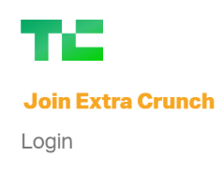
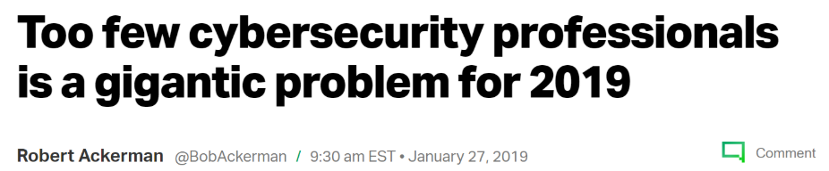
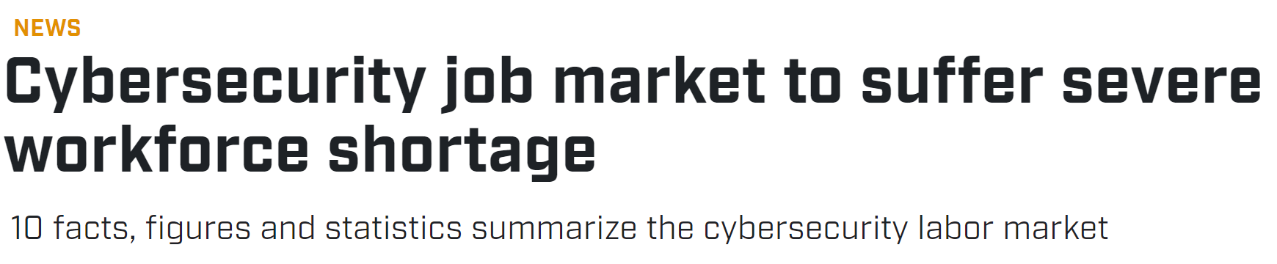
The industry needs you and there are many job openings
From June 2019 through May 2020, there were 171,000 openings for Information Security Analysts, but only 125,000 workers currently employed in those positions – an annual talent shortfall of 46,000 workers for the industry’s most common role.
There are 336,000 additional openings requesting cybersecurity-related skills.
(ISC)2 — the world’s largest nonprofit association of certified cybersecurity professionals— said there is now a gap of almost 3 million cybersecurity jobs globally.
Notes:
[Lauren] There is no exact start date for the creation of the cybersecurity industry but its creation can be dated back to roughly the 1970s. This, of course, means that its a relatively young industry and many of the founders of the industry and definitely many founders of the fields within it are still alive and working. The industry has grown really rapidly and at present is seen as one of the key industries globally and in the US specifically with an annual talent shortfall and projections indicate this shortfall will continue.
So to quantify that gap, as shown on the slide, from June 2019 through May 2020, there were 171,000 openings for Information Security Analysts, but only 125,000 workers currently employed in those positions – an annual talent shortfall of 46,000 workers for the industry’s most common role. These numbers are always tough to quantify because as explained later in class there are a lot of different job titles that relate to work in the field.
However, a rough estimate would indicate that there are at least 336,000 additional openings requesting cybersecurity-related skills in the US alone.
(ISC)2 — the world’s largest nonprofit association of certified cybersecurity professionals— said there is now a gap of almost 3 million cybersecurity jobs globally.

Slide 41
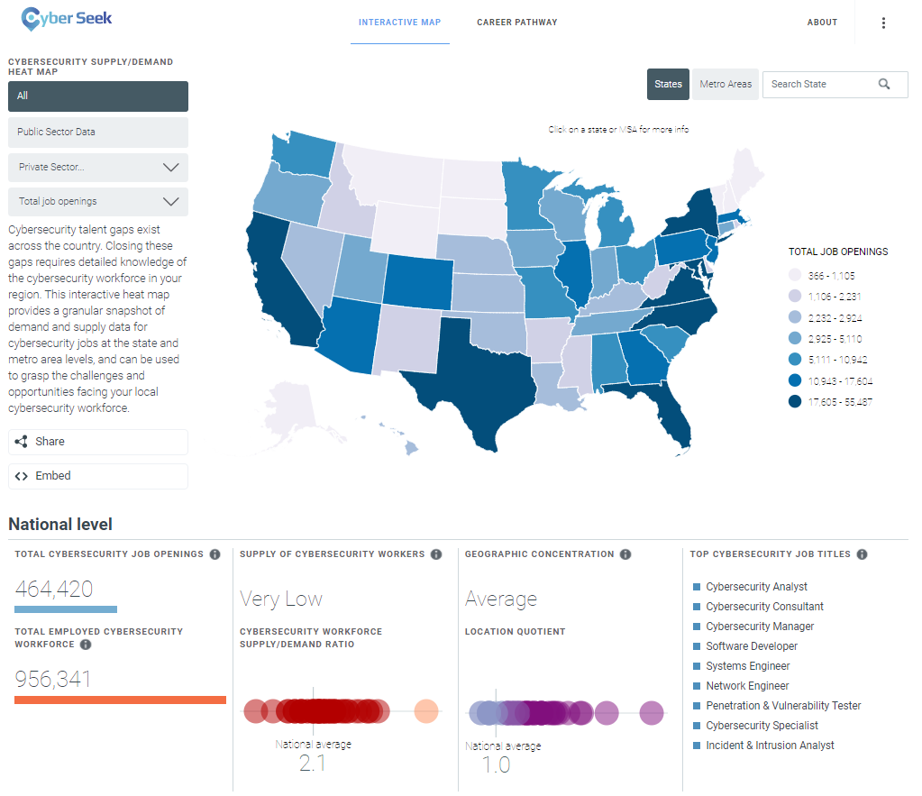
Talent gaps nationwide
Notes:
Heatmap from https://www.cyberseek.org/heatmap.html which is part of NIST’s NICE effort to understand talent shortages in the industry.

Slide 42
Cybersecurity is a relatively young industry
The industry is really young and so that means that most of the founders of the field are alive!
1950s - Phone phreaking used by hackers to make free calls
1952 - NSA created
1950s - First commercial computers sold
1972 - Creation of ARPANET and the first worm
1983 - first cybersecurity patent (RSA encryption)
1987 - first commercial antivirus products
1990s - malware variants explode
1993 - first DEF CON
1999 - Melissa virus uses email as a distribution vector
2001 - first watering hole attack
Early 2000s - first public discussion of zero days and their criticality in security
2007 & 2008 - iPhone and Android smartphones released and accompanying mobile malware
2012 - First publication of major credit card dump online
2013 - Snowden revelations
2013 - Mandiant APT1 Report
2013-2014 - spree of consumer facing breaches (e.g. Yahoo, Target, Sony, JPMC)
2016 - US election DNC targeting & use of FB to spread disinfo
2017 - WannaCry ransomware
2021 - Colonial pipeline ransomware
Notes:
The cybersecurity field is relatively young and so an exciting part of being in this industry is that not only will you get a front row to see history unfold but most of the legendary founders and shapers of the field are not only alive they are actively still working in the field.
The content on this slide is just meant to help indicate how recent many of the landmark historical moments in this field have been. The first commercial sale of a cybersecurity service was in 1987!! That means that everyone in this room has lived through most of the development of this entire industry. Entire foundational concepts such as malware, zero days, eCrime, private sector intelligence reporting, public sector offensive and defensive security efforts, internet-enabled disinformation have come into existence in the past 20-30 years.
This means that you can not only learn from but work with and hopefully become one of the people who is highlighted in history as shaping the future of this field. This is personally really motivating to me - I took a class at Harvard for fun just because it was taught by one of the individuals who created ARPANET, later I applied to work at Facebook in large part because Jen Weedon was going to work there and she played a role in writing the APT1 paper, and she’ll kill me for saying this but April is one of the people who discovered the 2016 Russian election interference and getting to see her work up close and to work together with her on investigations is a privilege.

Slide 43
Culture of the cybersecurity community
The industry prides itself on a hacker culture centered on individuals who learn through doing with a strong streak of punk culture mixed with the strong influence of government work.
The industry is one of the least diverse but is trending slowly towards an increasingly diverse workforce:
Women 11.4%
White 79.8%
Black or African American 11.9%
Asian 6.9%
Hispanic or Latino 15.8%
The industry is also aging towards retirement!
Only 7% of the cybersecurity workforce is under the age of 30
Notes:
The cybersecurity industry refers to itself as a community and although it has grown tremendously there is still a tight knit culture within many of the fields within cybersecurity. The industry prides itself on a hacker culture centered on individuals who learn through doing with a strong streak of punk culture mixed with the strong influence of government work. This leads to an interesting workforce largely comprised of people who learned cybersecurity through hands on work either rooted in a personal interest in hacking, work in IT, or military service. Almost no one in the field has a degree in cybersecurity although this will undoubtedly shift over the coming years as universities align their course offerings to meet the market demands.
While there are many extraordinary aspects of being in such a tightknit industry one failure of the US cybersecurity industry is that the industry does not represent the diversity of country. Only 11% of people in the industry are women which is one of the lowest rates of representation of women in any field in the country. Similarly nearly 80% of people working in the field identify as white. Finally, the existing cybersecurity workforce is aging towards retirement and the replacement rate data is not trending in a good direction! Only 7% of the workforce is under the age of 30. This must change and is changing as is evidence by the interest in a course such as this. At a personal level I would never have been in this industry if a woman hadn’t suggested I apply, if a woman hadn’t taken a risk to hire me, and if male mentors hadn’t helped me to learn on the job. I really want to help each every person in this room to find a job in cybersecurity if that is the path you want to take so whether it is during this class or 5 years from now please do not hesitate to reach out to me if I can assist you on that path.
https://www.bls.gov/cps/cpsaat11.htm

Slide 44
Categories of organizations in the industry
Private Sector
Organizations with an in-house cybersecurity team
Consulting firms
Product companies
Information vendors
Public Sector
Defensive (e.g. CISA)
Offensive (e.g. NSA)
Investigative (e.g. FBI)
Regulators (nascent)
In-house teams (every agency)
Notes:
Every single industry today has cybersecurity needs. Therefore, in-house cybersecurity teams exist everywhere. But be aware that cybersecurity knowledge is generally limited across industries and because of this there is little standardization in where security teams sit. Some companies will have a security org, some will have security within IT, some will have security within Legal, some have it embedded across the company in many teams. So don’t look for a cyber security team or be dissuaded if the position has an odd title or odd role.
The clear difference between 1 and 2-4 is that in 1 you are a cost center whereas in 2-4 you are a revenue generator. This makes a serious difference. In consulting you have boutique consulting firms specializing in cybersecurity (e.g. pen testing) and you have the large firms with huge security practices. Pros and cons here. You get to see lots of different industries and different roles within the industry. However, because of that your knowledge can be a mile wide and an inch deep.
Have all sort of roles (sales, business development, PM, eng, customer integration, etc). In these companies you are often going to need to be at an engineer’s level to be able to do technical work in the industry.
Information vendors are similar to 2 & 3. They are selling reporting which tends to require more of a hybrid skillset.

Slide 45
Sectors within the Cybersecurity industry
Security architecture
Vulnerability and patch management
Cyber threat intelligence
Security Operations Center (SOC)
Incident response
Security operations
Compliance
Network defense
Security risk assessment
Security audit
Cybersecurity project management
Penetration testing
Cyber threat hunting
Information security engineering
Notes:
We already know that we have our work cut out for us learning to code but that’s not the sole focus of this class. This class is meant to be an applied class through which all of the python we learn is in service of giving you skills that will directly apply to a role in the cybersecurity industry. Therefore, it is critical that you walk away from this class with an understanding of the industry, a sense for what parts of the industry interest you, and an understanding of how scripting skills will set you up for a successful career in the field. These are some of the fields within the cyber security industry and you can get a job in nearly any of these fields without learning to program. Programming doesn’t so much determine whether or not you can be in the field but does determine what types of organizations you can work for within the field. Programming can be applied across all of these fields to make your work more efficient. In class three we are going to spend more time providing an overview of what each of these roles entails and the paths into these fields; however, please don’t hold any industry questions back. We both specialize in threat intelligence and so our knowledge is deepest in that area. We would be happy to share what we know or connect you to people who works in any field within the industry especially if you are interested in a field with which we are less familiar.

Slide 46
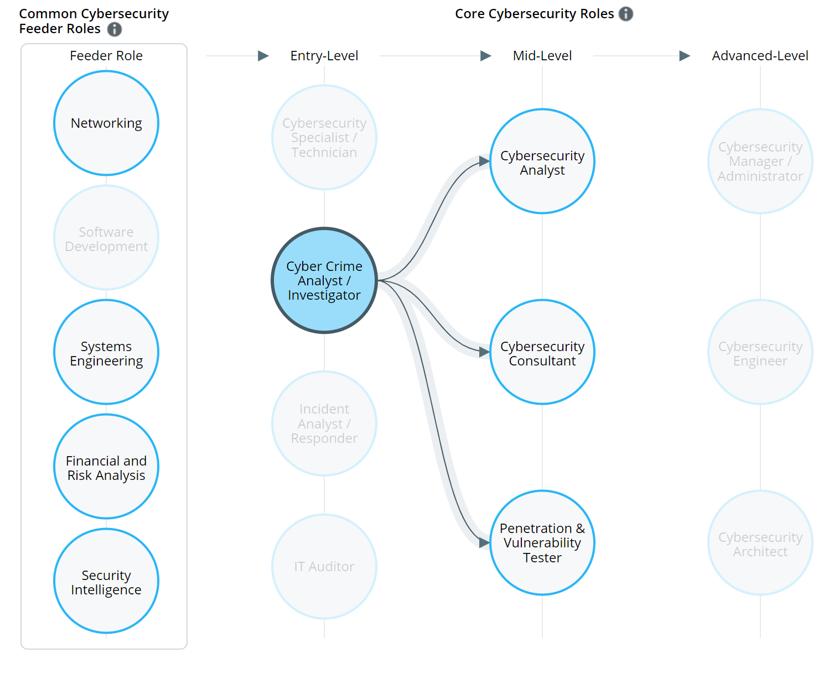
Industry roles
Each sector has sector-specific roles focused on areas such as:
Penetration tester
Cyber threat hunter
Security engineer
Security architect
Vulnerability and patch manager
Threat intelligence analyst
Security Operations Center (SOC) operator / analyst
Incident responder
Malware reverse engineer
Security auditor
Compliance manage
Notes:
I highlight this because knowing the terminology associated with roles in the field is important as you start to read about the field, as you job hunt, and as you figure out what skills you need to get a role in the industry.

Slide 47
How does scripting skill factor into work in the industry?
Scale your work
Automate routine functions
Access data without having to wait for a tool to be built
Find patterns in data you were unlikely to find using manual approaches
Every sector within cybersecurity has roles which both do and do not require scripting skills.
Scripting will generally open up opportunities to do the following:

Slide 48
Technical vs scripting vs coding interviews
One of the challenges to applying for a role in cybersecurity is that your interview process can vary widely and these three terms may sound similar but are typically different:
Technical interview
Scripting interview
Coding interview
Notes:
One of the challenges to applying for a role in cybersecurity is that your interview process can vary widely and these three terms may sound similar but are typically different:
Technical interview
This is the most vague but likely involves technical scenario based questioning in which you want to demonstrate clear comfort with technical topics, knowledge of the appropriate tools to use in different scenarios, and awareness of the other partner teams you might work with on different issues.
Scripting interview
Will involve live coding either on a whiteboard or on the computer in a tool like CoderPad. Generally looking for a narrower set of languages and lower level of skill then in a full coding interview.
Coding interview
Will involve live coding either on a whiteboard or on the computer in a tool like CoderPad. Looking for a high level of skill with multiple languages and ability to debug and try multiple paths to accomplish the same problem.

